Slide 1
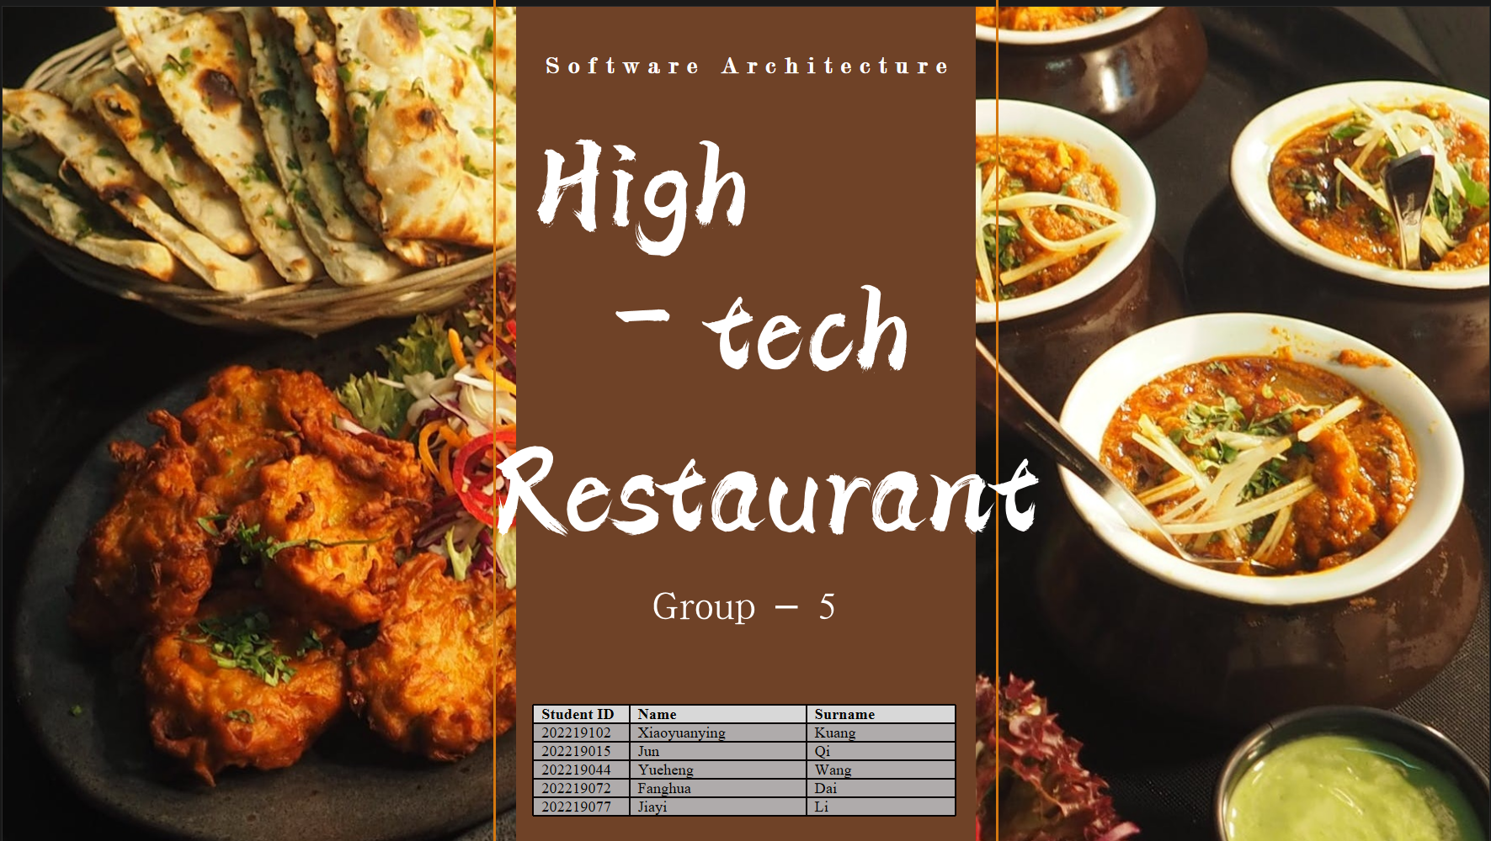
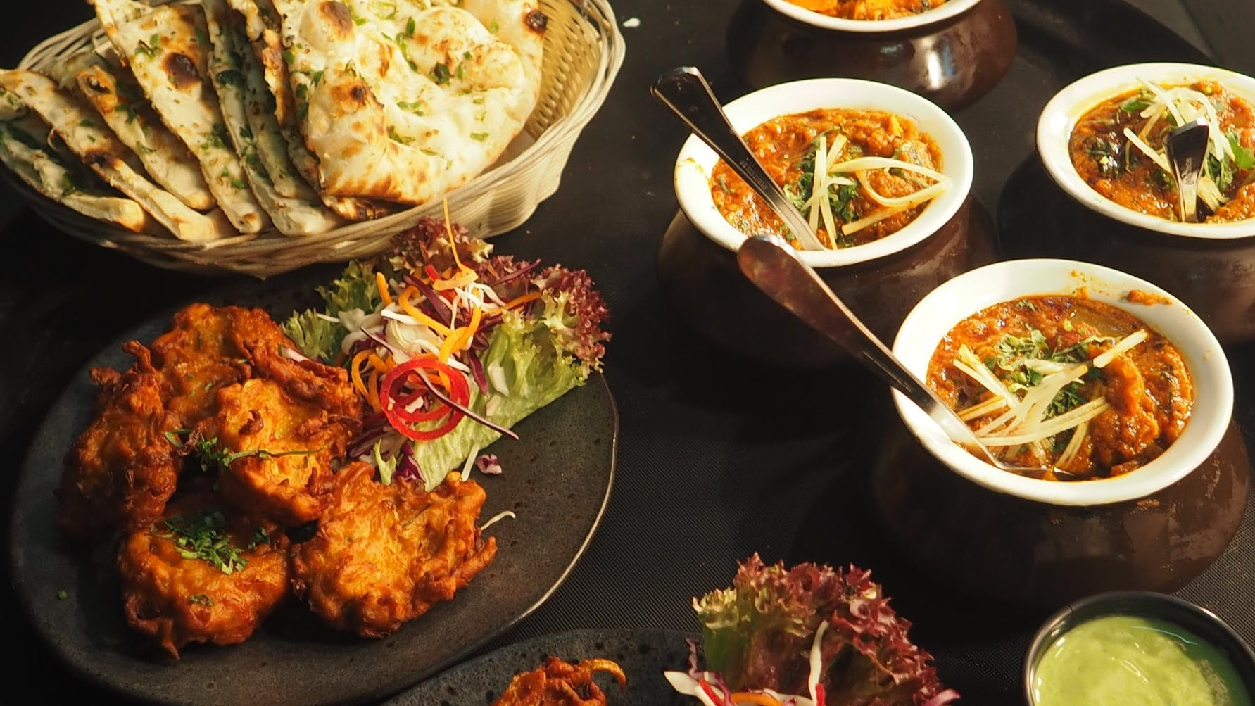
Software Architecture
High-
tech
Restaurant
Group - 5
Student ID | Name | Surname
202219102 | Xiaoyuanying | Kuang
202219015 | Jun | Qi
202219044 | Yueheng | Wang
202219072 | Fanghua | Dai
202219077 | Jiayi | Li

Slide 2
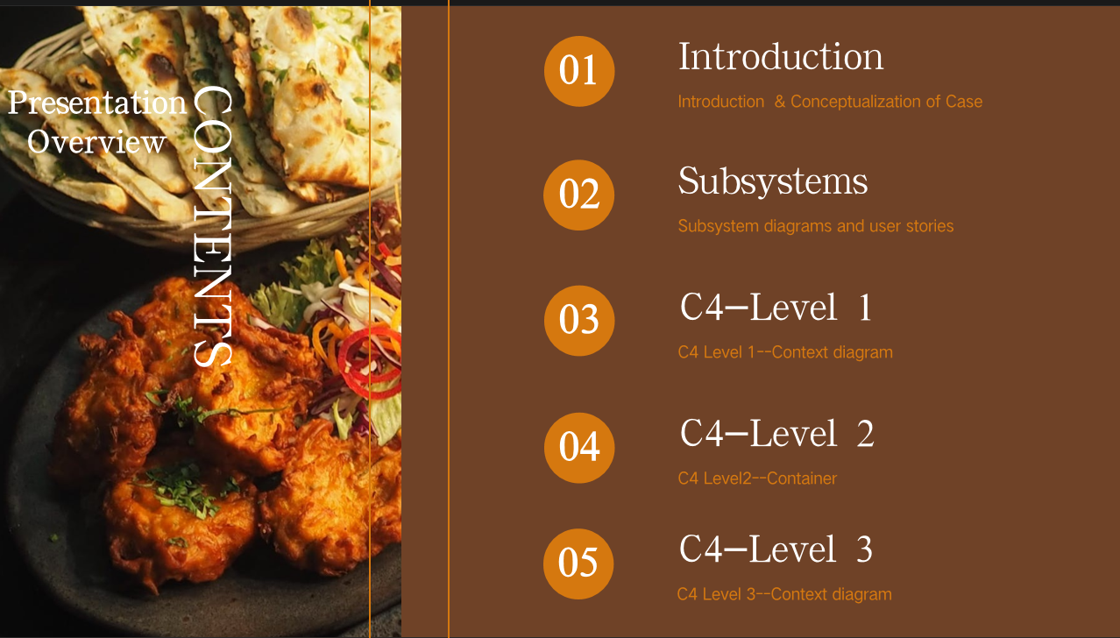
01
Introduction
Presentation Overview
CONTENTS
Introduction & Conceptualization of Case
02
Subsystems
Subsystem diagrams and user stories
03
C4-Level 1
C4 Level 1--Context diagram
04
C4-Level 2
C4 Level2--Container
05
C4-Level 3
C4 Level 3--Context diagram

Slide 3
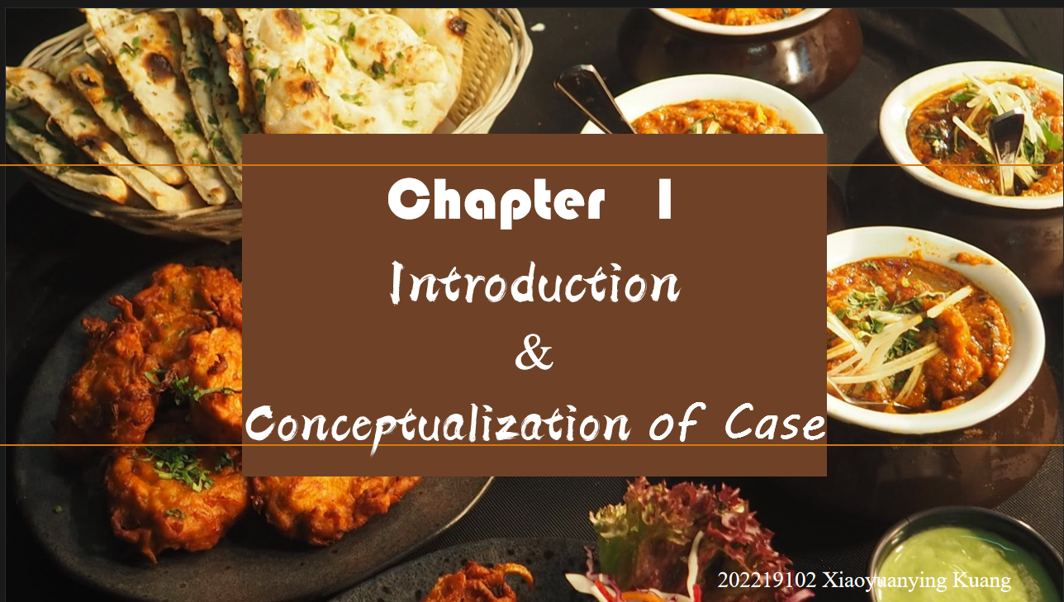
Chapter 1
Introduction
&
Conceptualization of Case
202219102 Xiaoyuanying Kuang

Slide 4
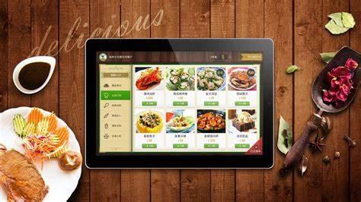

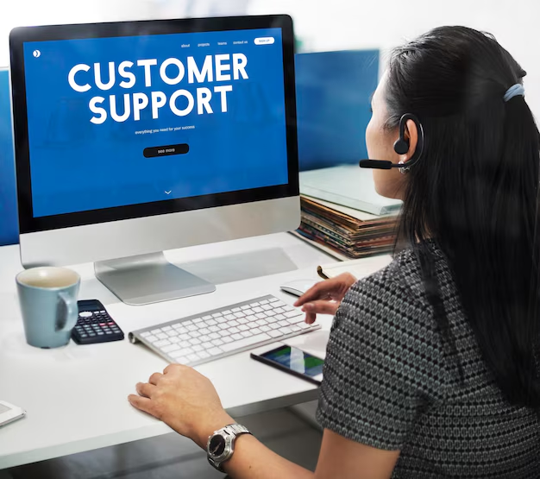

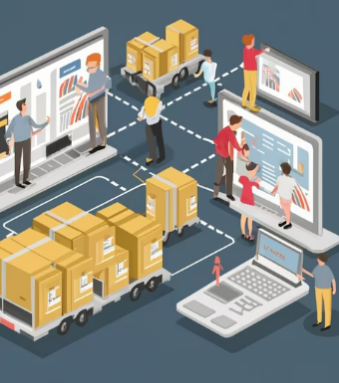
Introduction To Case Study
5# - High-tech Restaurant.
The restaurant maintains an electronic catalogue for the list of food and beverage items that it provides. Meal customization is supported. Customers are provided by a unique APP to order food and pay bill on premises, to order online and to make bookings. An extended customer record is maintained, so it is possible to build a profile for the different customers. Data collection includes traditional user data (e.g. requested meals/beverages) integrated with additional data (e.g. time of purchase or visit, number of people attending, etc.) to increase the profile accuracy. Premium customers are awarded with discounts, as well as customised offers based on the profile generated are periodically sent to customers. The platform is connected to suppliers and provides an automated estimation of food/beverage requests through an external AI-powered service. These requests are validated by the manager in the system and, then, is automatically sent to the different providers. A similar service is available to connect food delivery services: a delivery request received through the restaurant APP can be automatically forwarded to the delivery company.
01
02
03
04
05
Order
Customer-Service
Delivery
Supply
Data- Storage

Slide 5




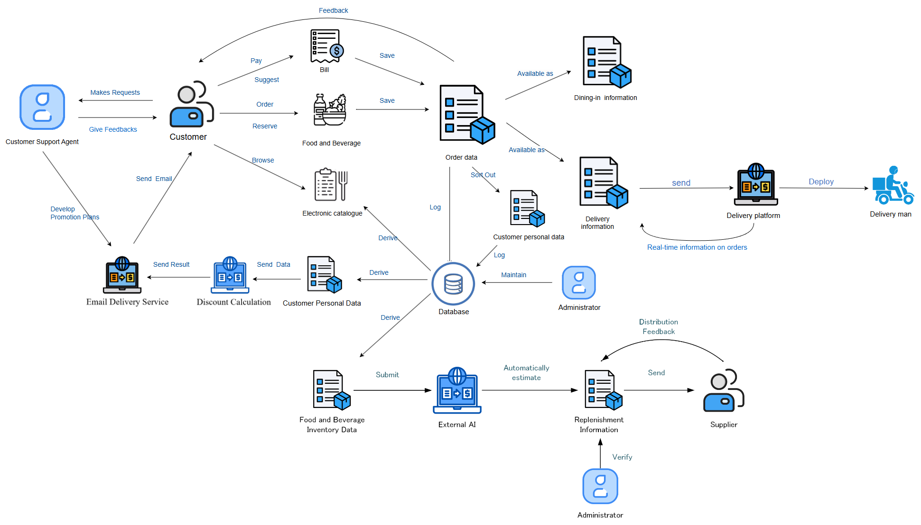
Conceptualization
①
An abstract simplified view of High-tech restaurant
Efficient collaboration
①
Transaction
Operation
Management
②
③
④
① ORDER
② DATABASE
③ CUSTOMER-SERVICE
④ DELIVERY
⑤ SUPPLY
⑤

Slide 6
Chapter 2
Subsystems
Subsystem diagrams and user stories

Slide 7

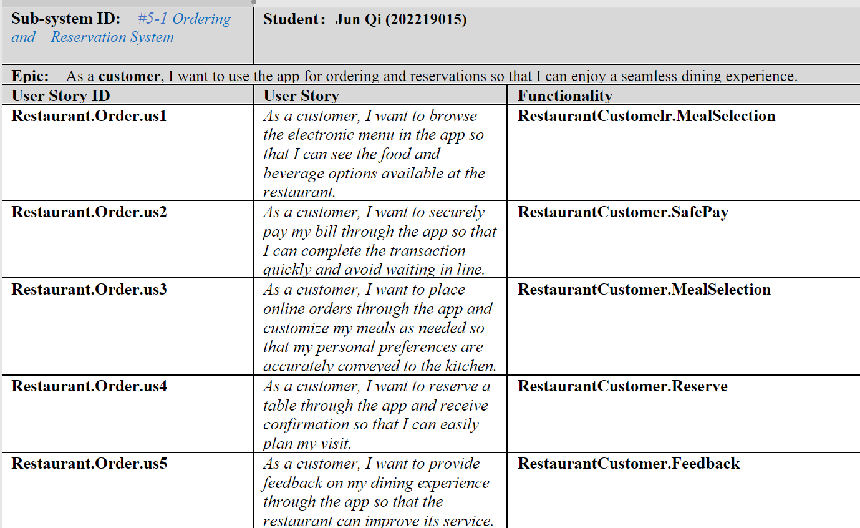
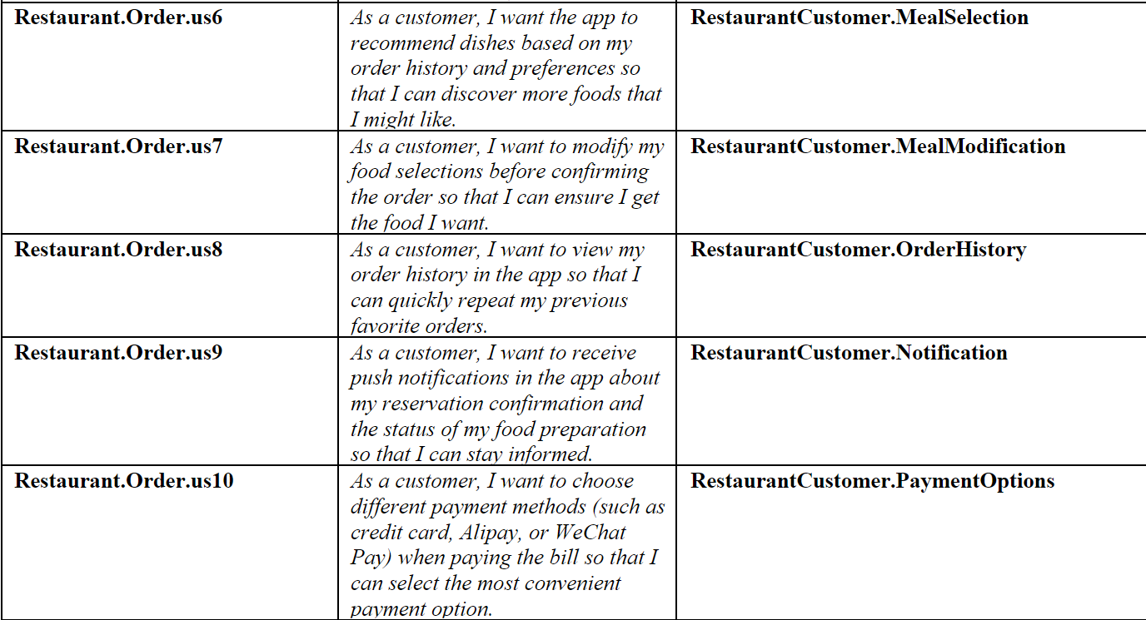
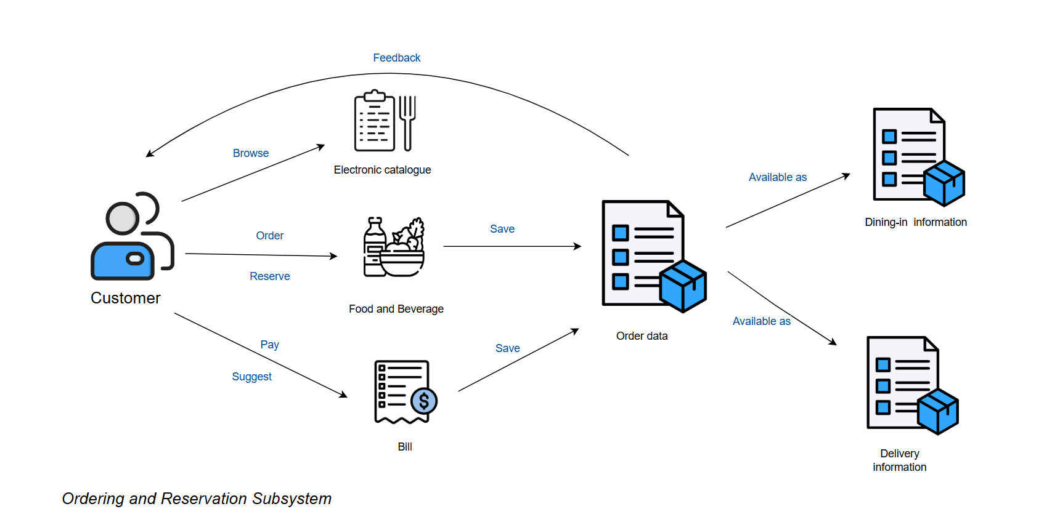
Order Subsystem
Meal Selection
Meal Selection
Meal Modification
Safe Pay
Order History
Meal Selection
Notification
Reserve
Feedback
Payment Options

Slide 8

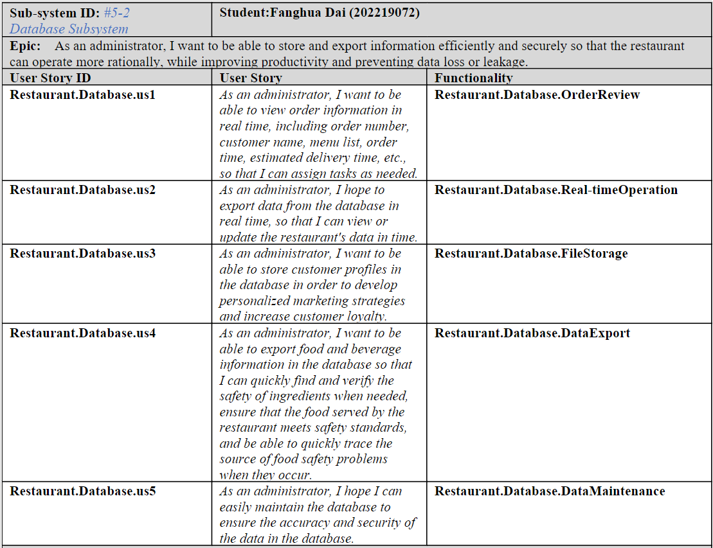
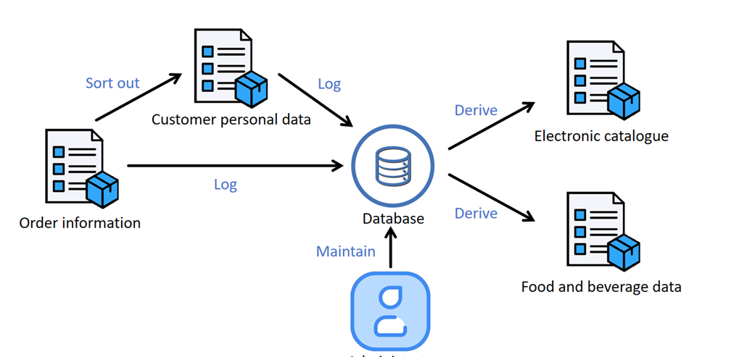
Database Subsystem
Order View
Real Time Operation
File Storage
Data Export
Data Maintenance

Slide 9

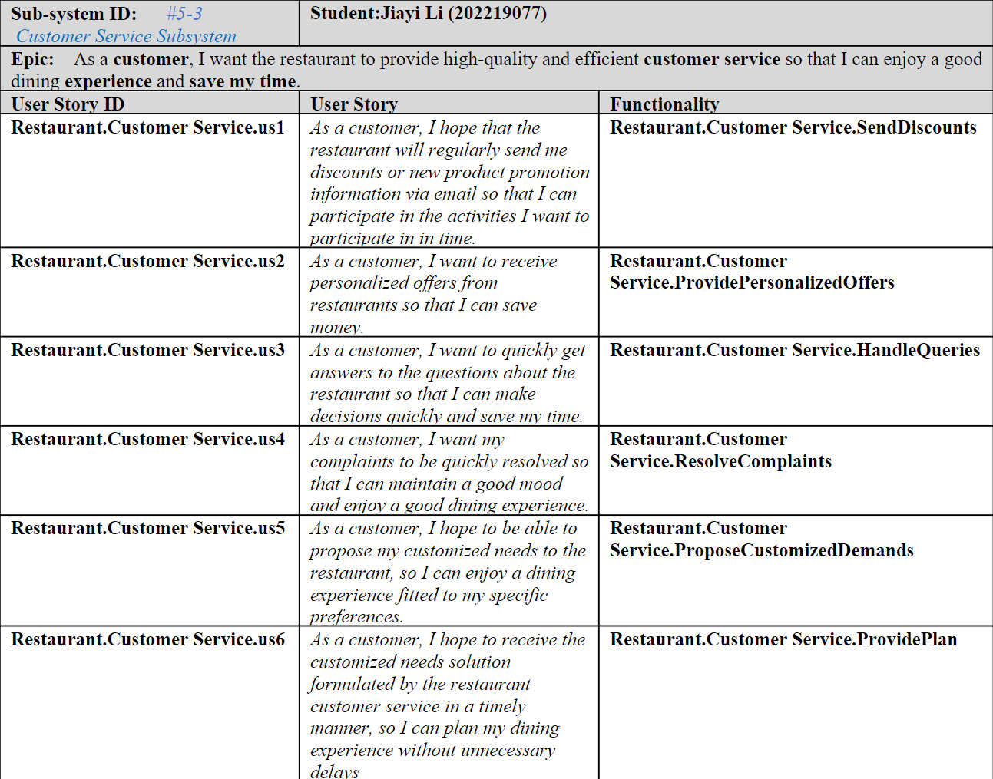
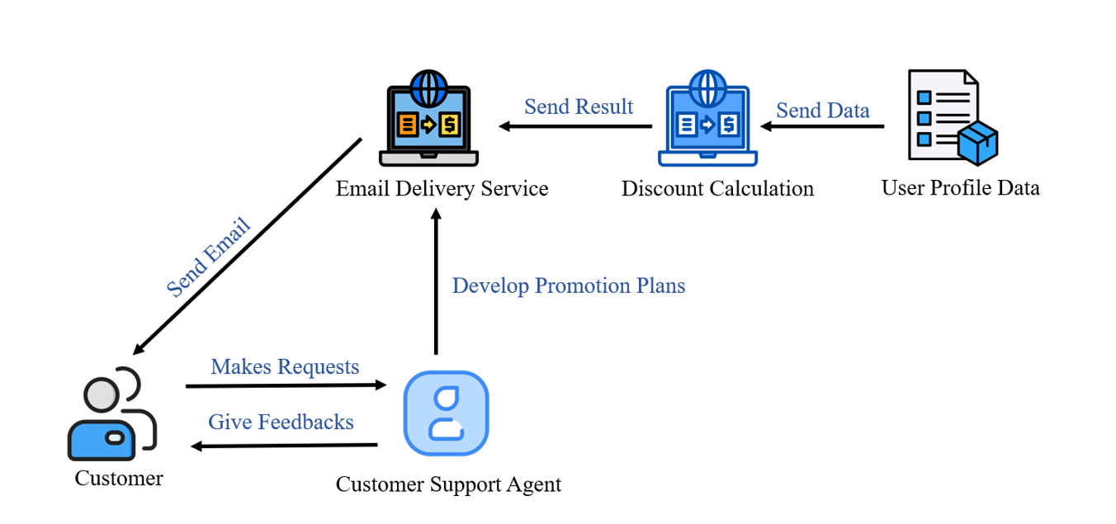
Costumer-service Subsystem
Send Discounts
Provide
Presonalized Offers
Handle Queries
Resolve Complaints
Propose Customized
Demands
Provide Plan

Slide 10

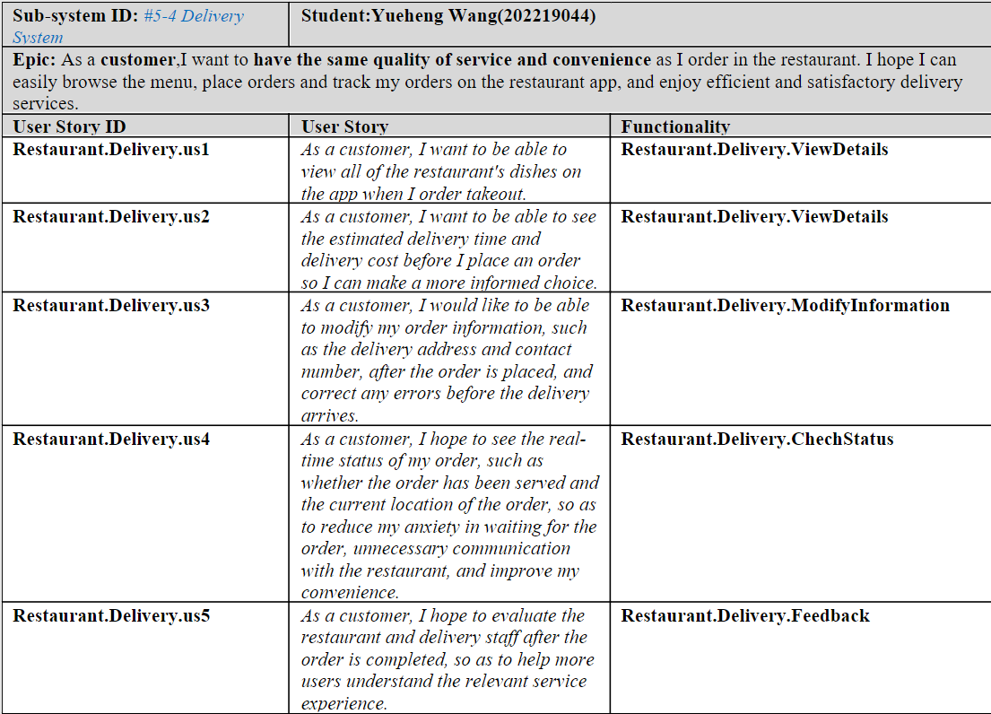
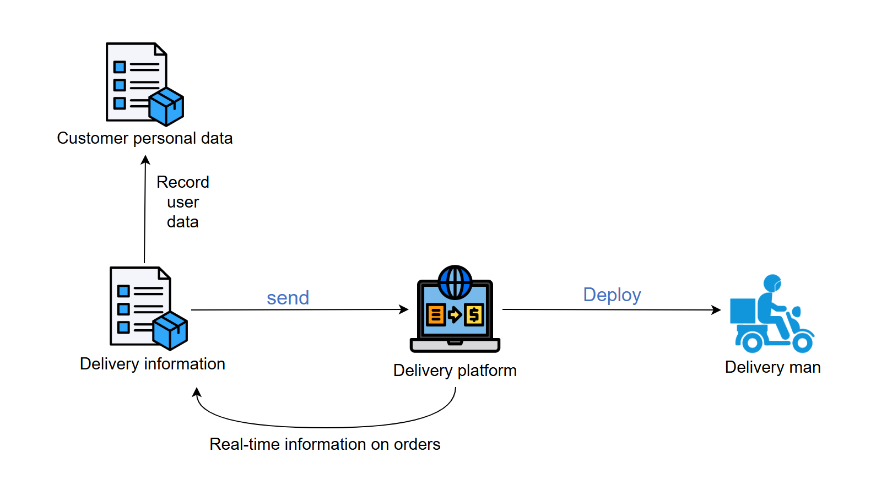
Delivery Subsystem
View Details
View Details
Modify Information
Chech Status
Feedback

Slide 11

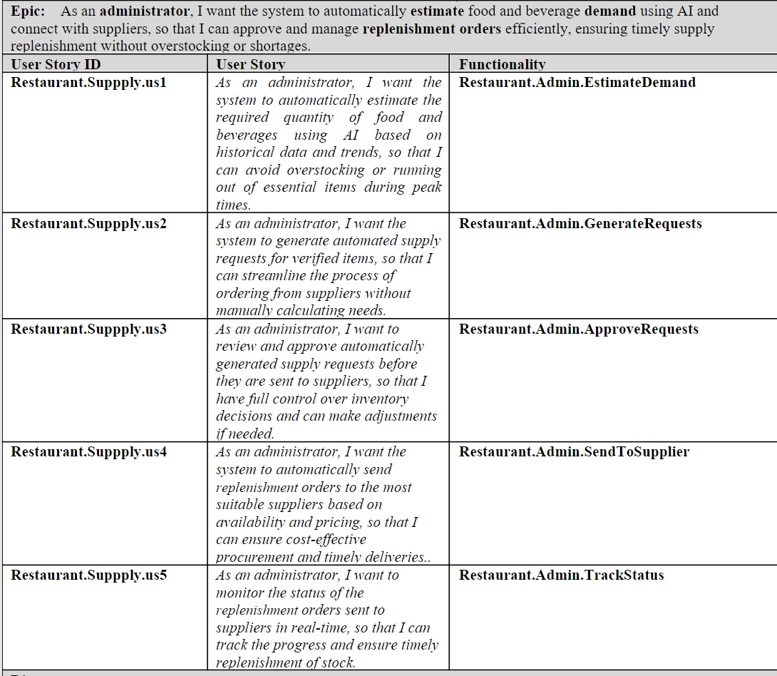
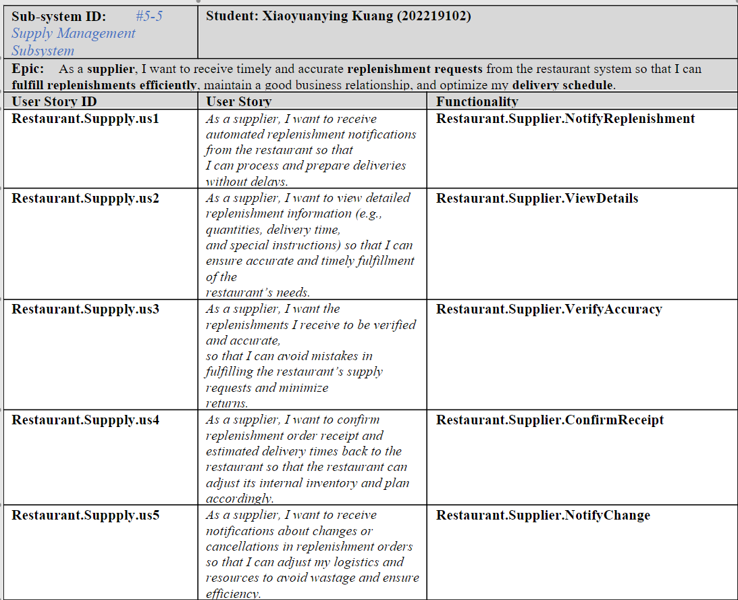
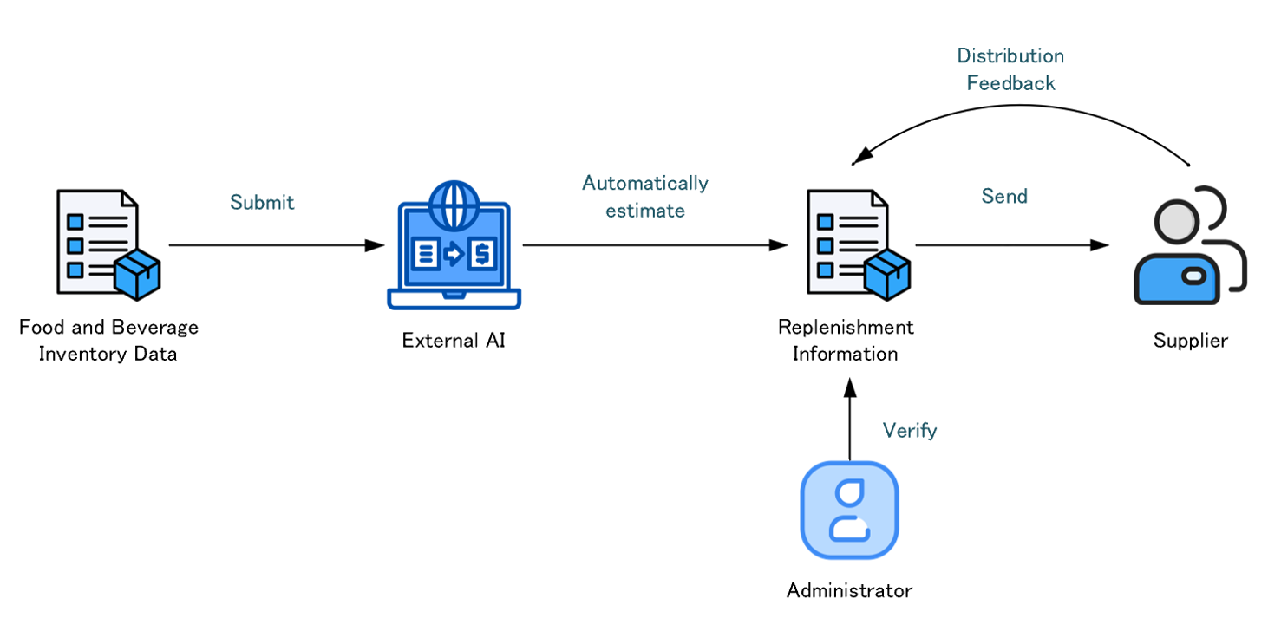
Supplier Subsystem
Estimate Demand
Notify Replenishment
Generate Requests
View Details
Approve Requests
Verify Accuracy
Confirm Receipt
Send to Supplier
Notify Change
Track Status

Slide 12
Chapter 3
C4-Level 1

Slide 13
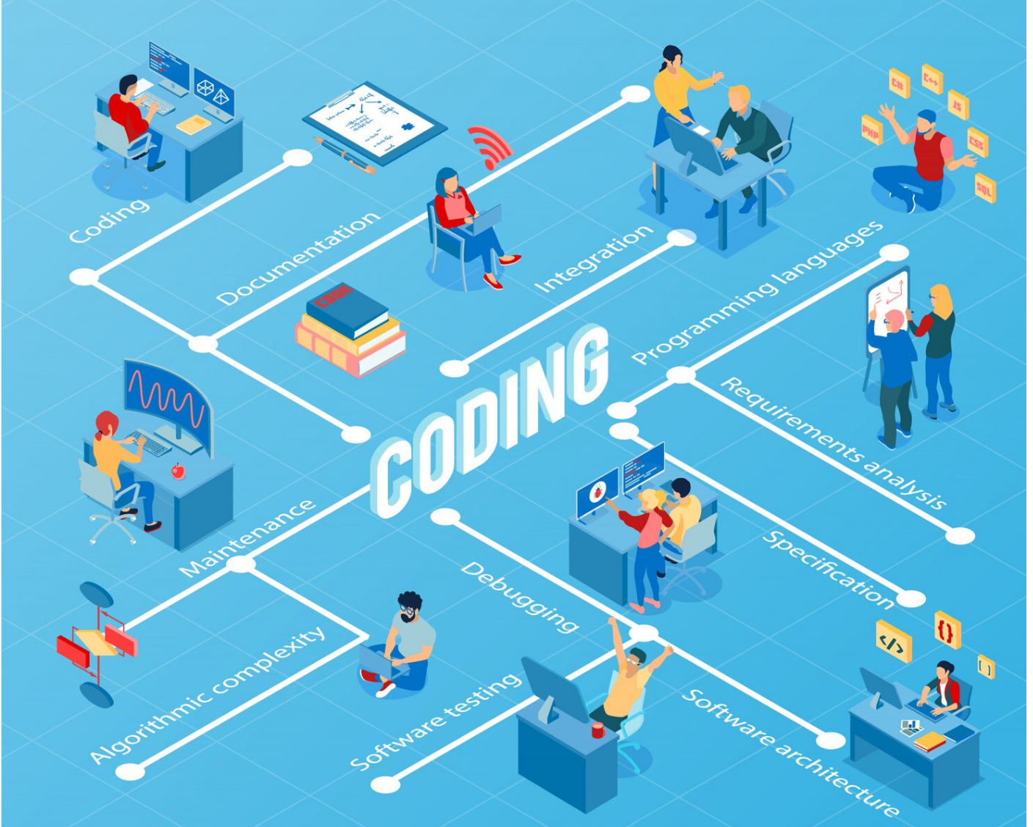
C4 Model
Top-down approach
01
Level 1
Context
Level 2
02
Container
03
Level 3
Component
04
Level 4
Code

Slide 14
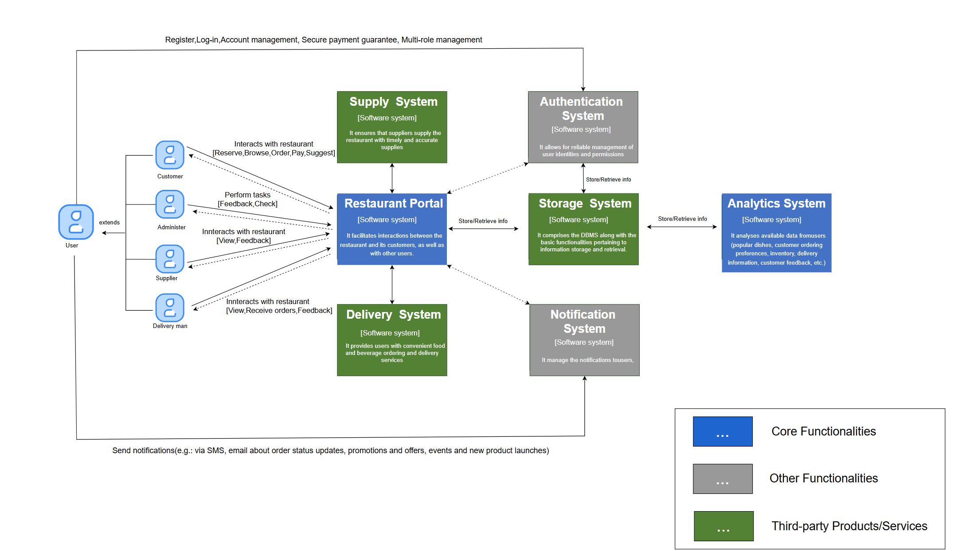

Level 1-Context
An holistic understanding of the target software architecture
Users
Main software system
Other Functionalities
Third-party Products/Services

Slide 15
Chapter 4
C4-Level 2
Container

Slide 16
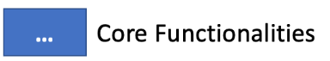
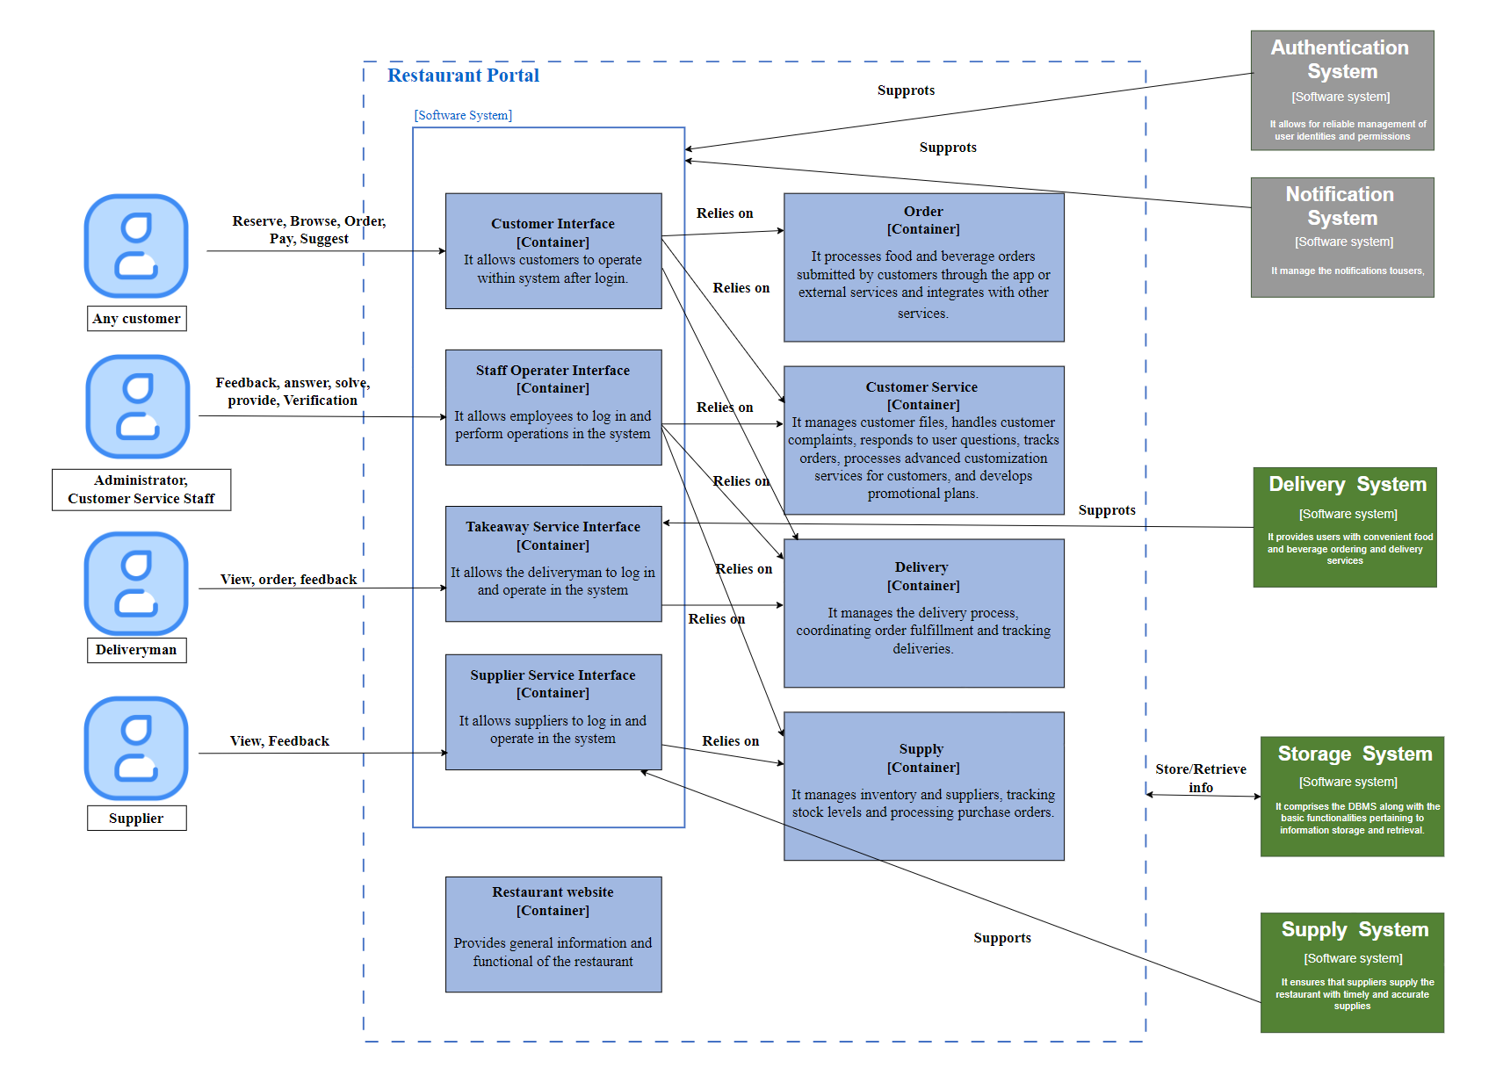
Container(Interface Type)
Level 2-Container
[Restaurant Portal Software System]
Other System
User
The most core software system.
It is the realization of the main function
4 kinds of users to use the system
9 countainers in total
4 of the interfaces
4 of the backends
1 of the frontend
Countainers Interact with other 5
software system
Countainers Relationships
relies on
suppots
sotre/retrieve info
Container(Frontend Type)
Container(Backend Type)

Slide 17
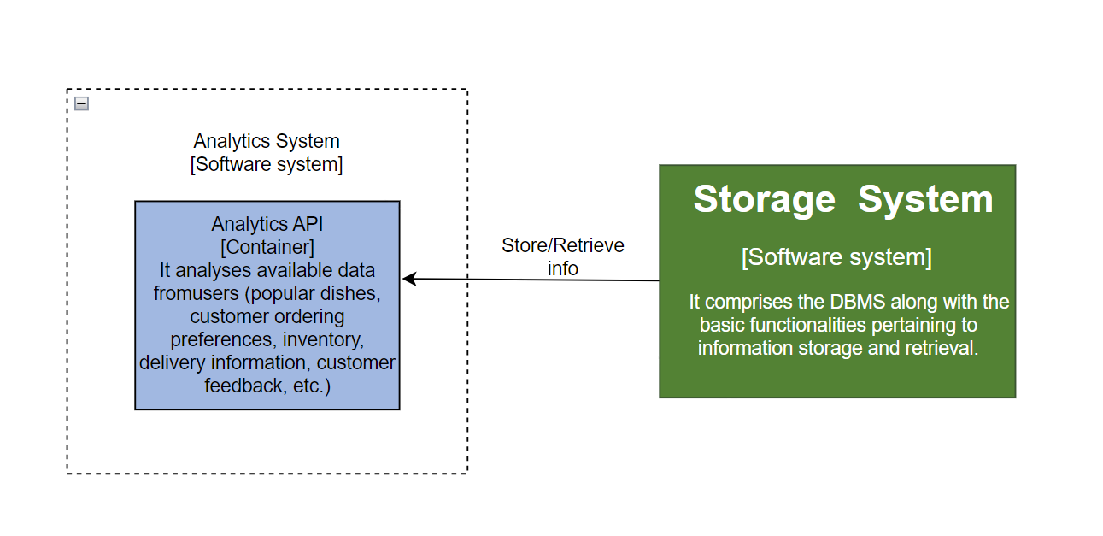
Level 2-Container
[Analytics Software System]
This API container mainly analyzes the user's available data to help restaurants make decisions.
It interacts with the database system software for data

Slide 18

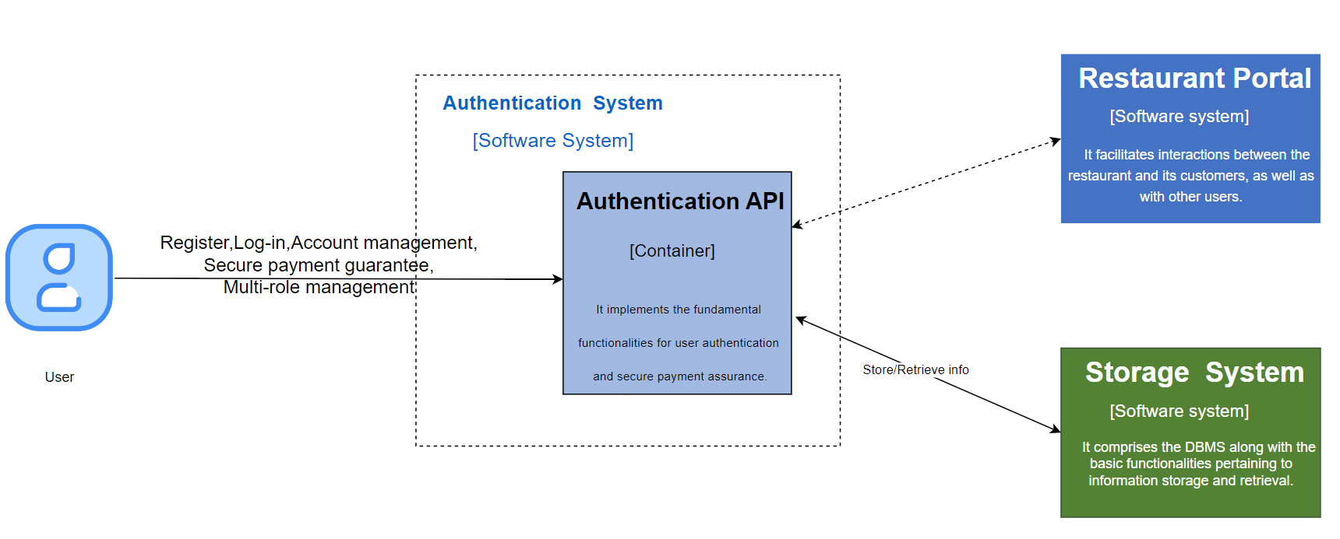
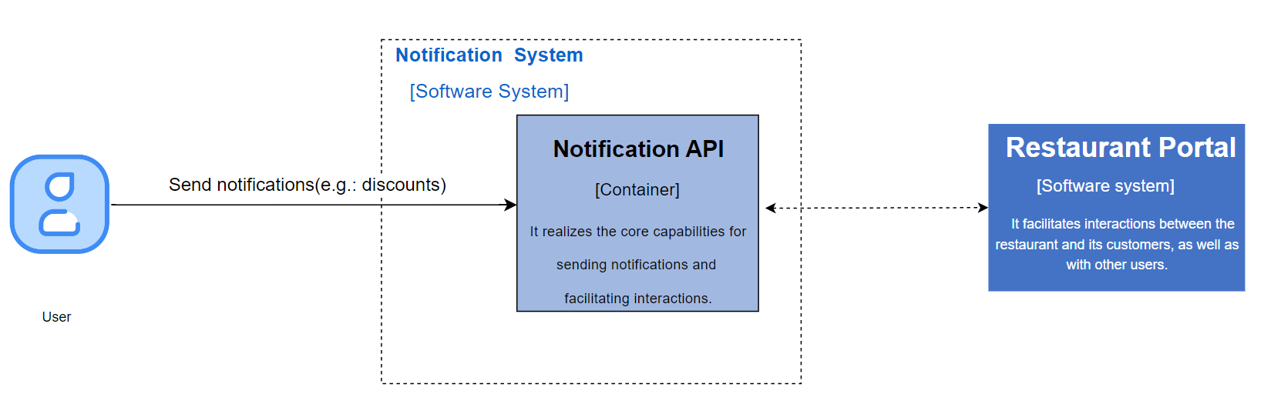
Level 2-Container
[Authentication and Notification Software System]
The API container mainly analyzes and processes the identity authentication of each user in the system to ensure system security.
The API container mainly handles system message push

Slide 19

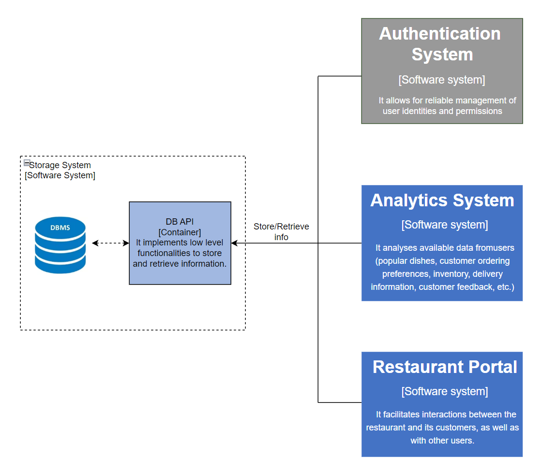
Level 2-Container
[Storage Software System]
This API Container mainly handles data storage and retrieval. It interacts with the database and provides support for other software systems.

Slide 20
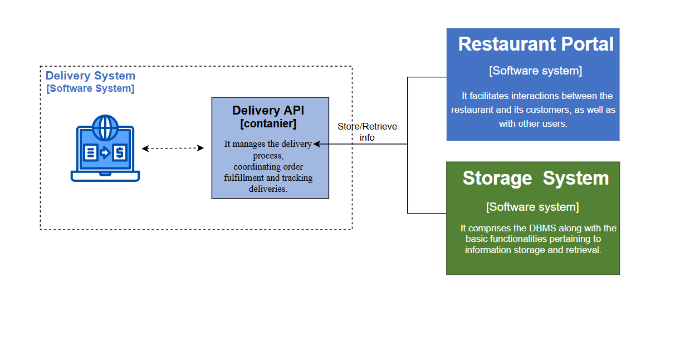
Level 2-Container
[Delivery Software System]
This API Container mainly handles the takeaway function

Slide 21
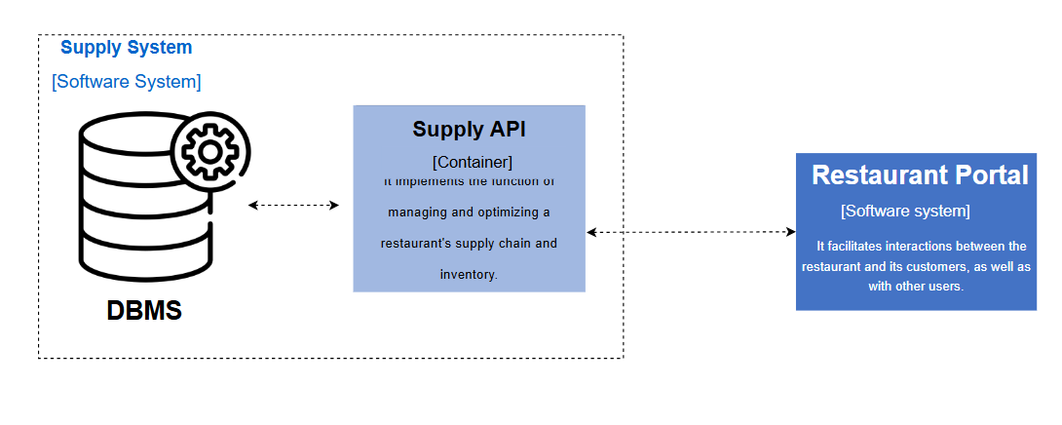
Level 2-Container
[Supply Software System]
This API Container mainly handles the supply and inventory of the restaurant

Slide 22
Chapter 5
C4-Level 3
Component

Slide 23
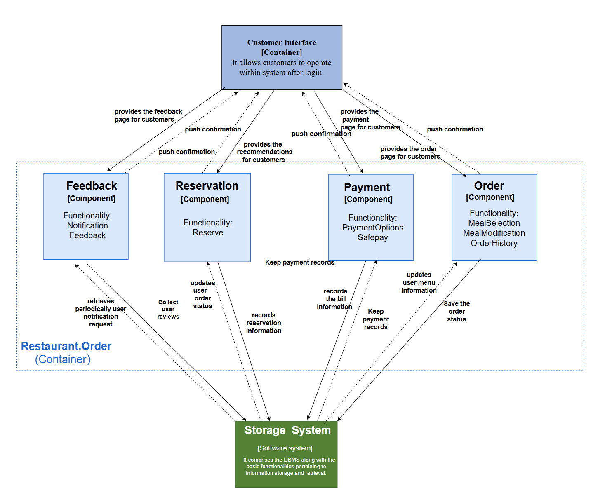
Level 3. Component
RESTAURANT.ORDER
In the Ordering and Reservation System, since the customer wants to use the app for ordering and reservations, the Software Architecture shown in the figure is designed to meet the customer's requirements.
ORDER
PAYMENT
01
Functionality: MealSelection,MealModification,OrderHistory
02
Functionality: paymentOptions Safepay
RESERVATION
FEEDBACK
03
Functionality: Reserve
04
Functionality: Notification,Feedback

Slide 24
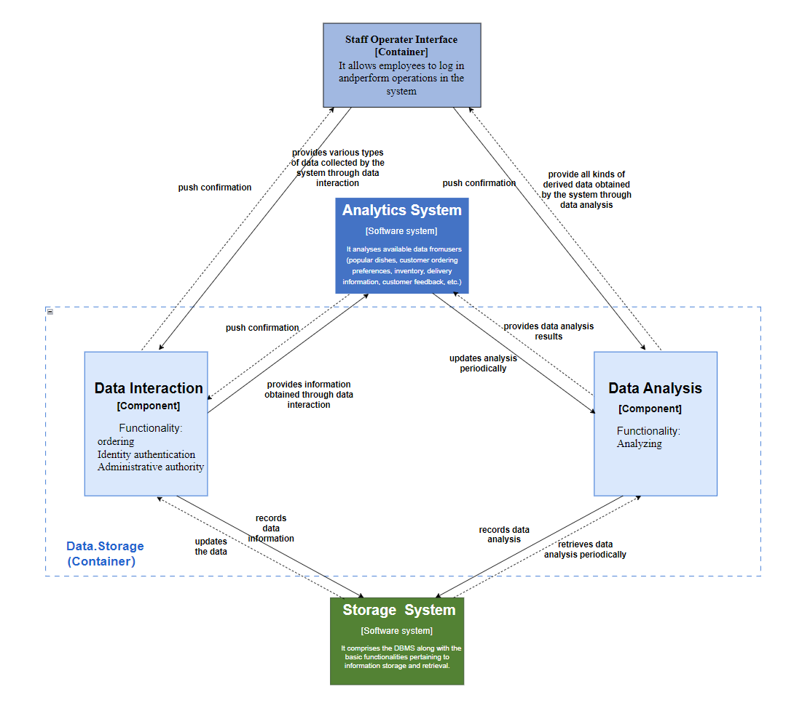
Level 3. Component
DATA.STORAGE
In the Database Subsystem, since the administrator wants to be able to store and export information efficiently and securely, the Software Architecture shown in the figure is designed to meet the requirements of administrators.
DATA INTERACTION
01
Functionality: Ordering, identify authentication, administrative authority
DATA ANALYSIS
02
Functionality: Analyzing

Slide 25
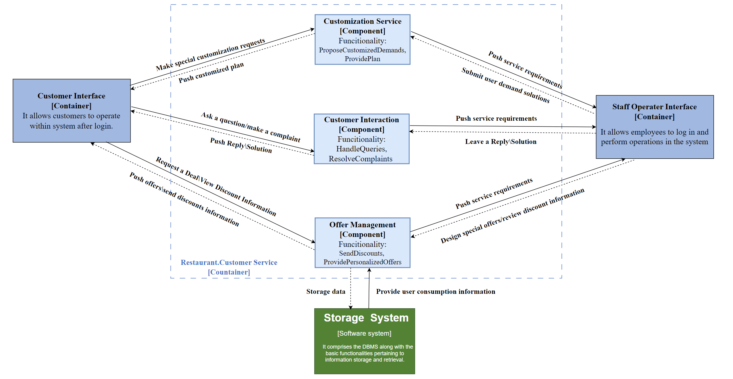
Level 3. Component
RESTAURANT.CUSTOMERSERVICE
In the Customer Service Subsystem, since the customer wants the restaurant to provide high-quality and efficient customer service, the Software Architecture shown in the figure is designed to meet the requirements of administrators.
CUSTOMIZATION SERVICE
01
Functionality: Propose customized demands, provide plan
CUSTOMER INTERACTION
02
Functionality: Handle queries, resolve complaints
OFFER MANAGEMENT
03
Functionality: Send discounts, provide personalized offers

Slide 26
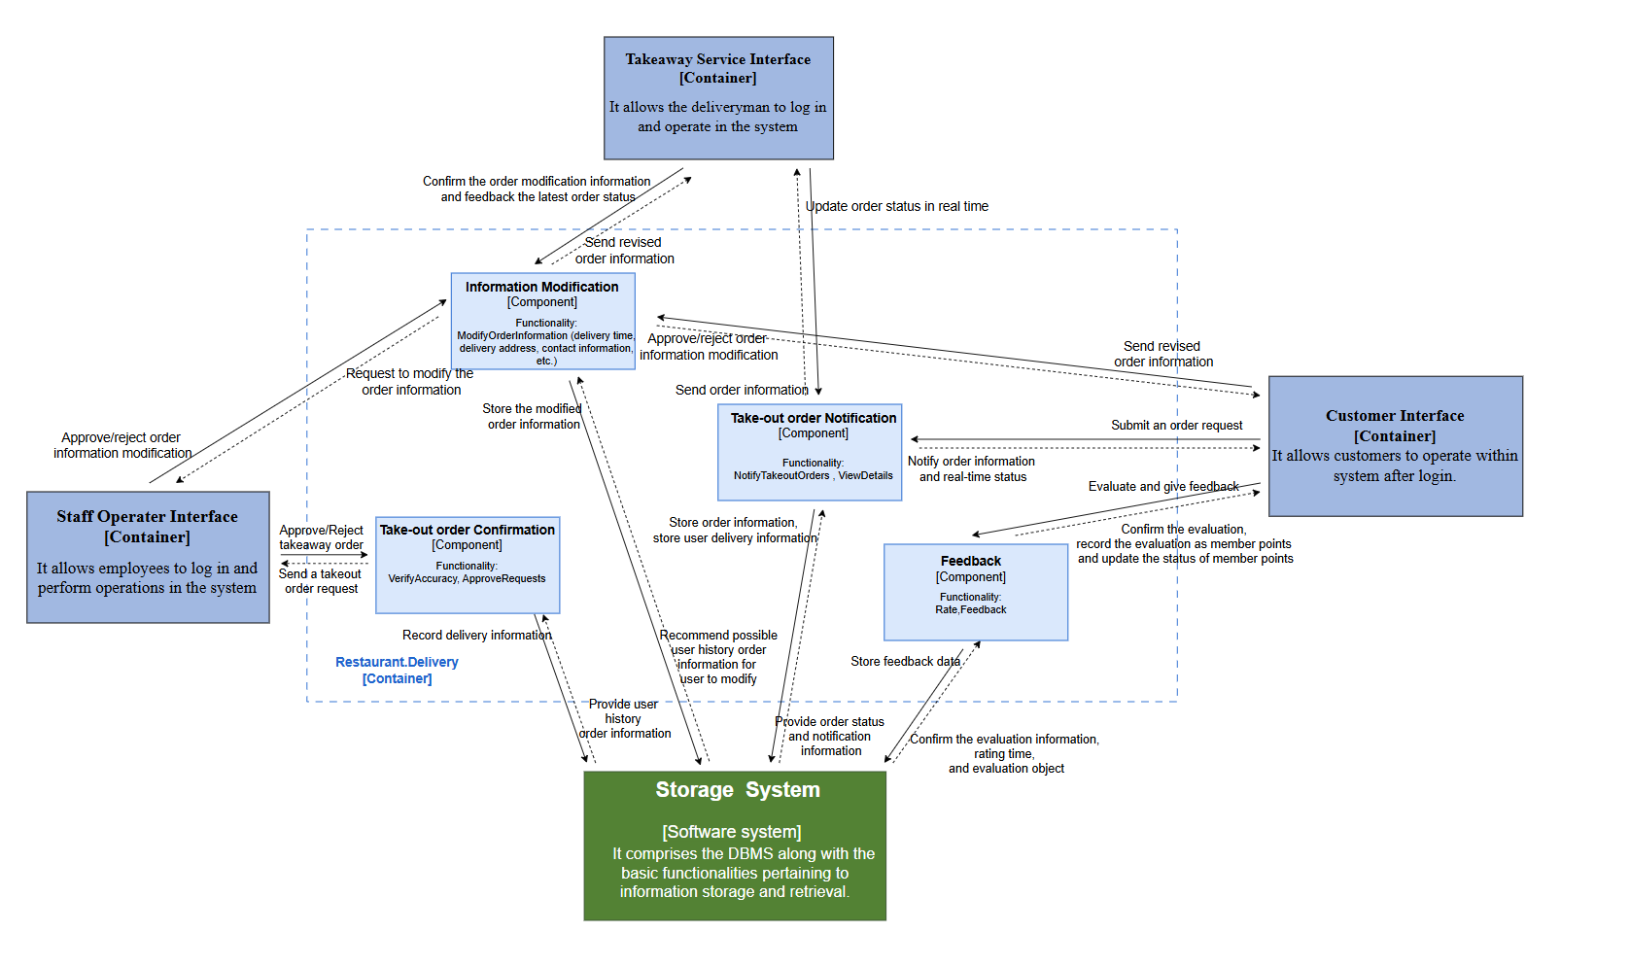
Level 3. Component
RESTAURANT.DELIVERY
In the Delivery System, since customers want to enjoy efficient and satisfactory delivery services, the Software Architecture shown in the figure is designed to meet their needs.
INFORMATION MODIFICATION
FEEDBACK
01
Functionality: Modify order information
02
Functionality: Rate, feedback
TAKE-OUT ORDER CONFIRMATION
TAKE-OUT ORDER NORTIFICATION
03
Functionality: Verify accuracy, approve requests
04
Functionality: Notify takeout orders, view details

Slide 27
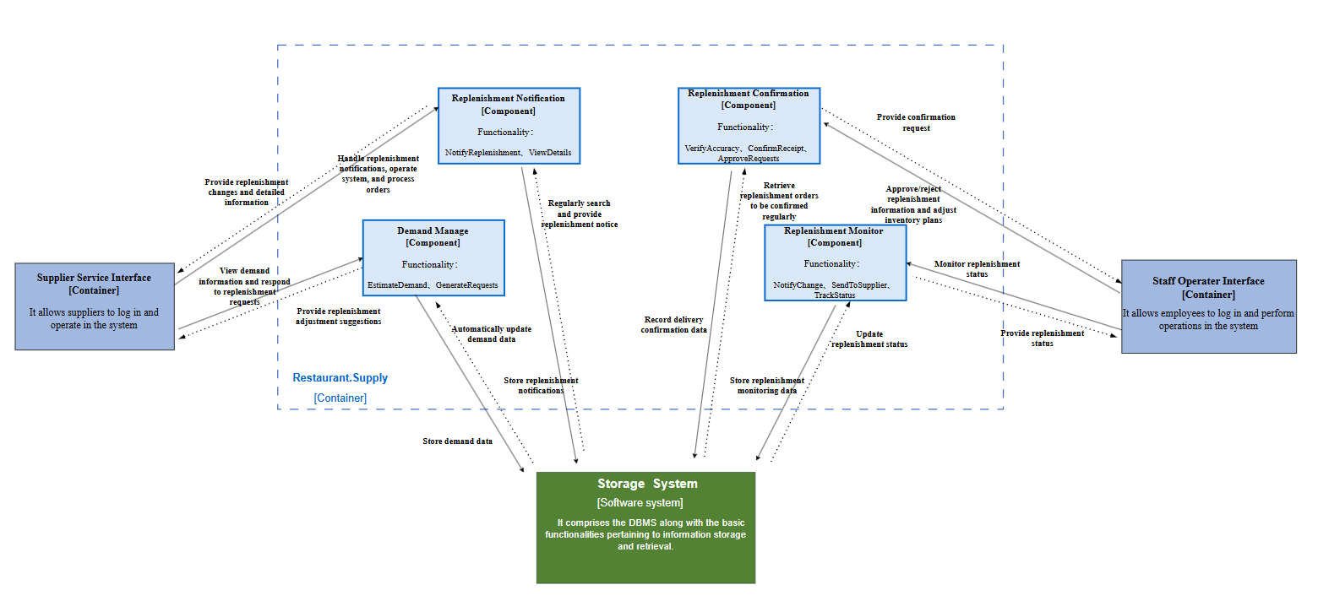
Level 3. Component
RESTAURANT.SUPPLY
In the Supply Management Subsystem, since the supplier wants to receive timely and accurate replenishment requests from the restaurant system, the Software Architecture shown in the figure is designed to meet the supplier's requirements.
REPLESHMENT NOTIFICATION
DEMAND MANAGE
01
Functionality: Nortify repleshment, view details
02
Functionality: Estimate demand, generate requests
REPLESHMENT CONFIRMATION
REPLESHMENT MONITOR
03
Functionality: Verify accuracy, confirm receipt, approve requests
04
Functionality: Notify change, send to supplier, track status

Slide 28
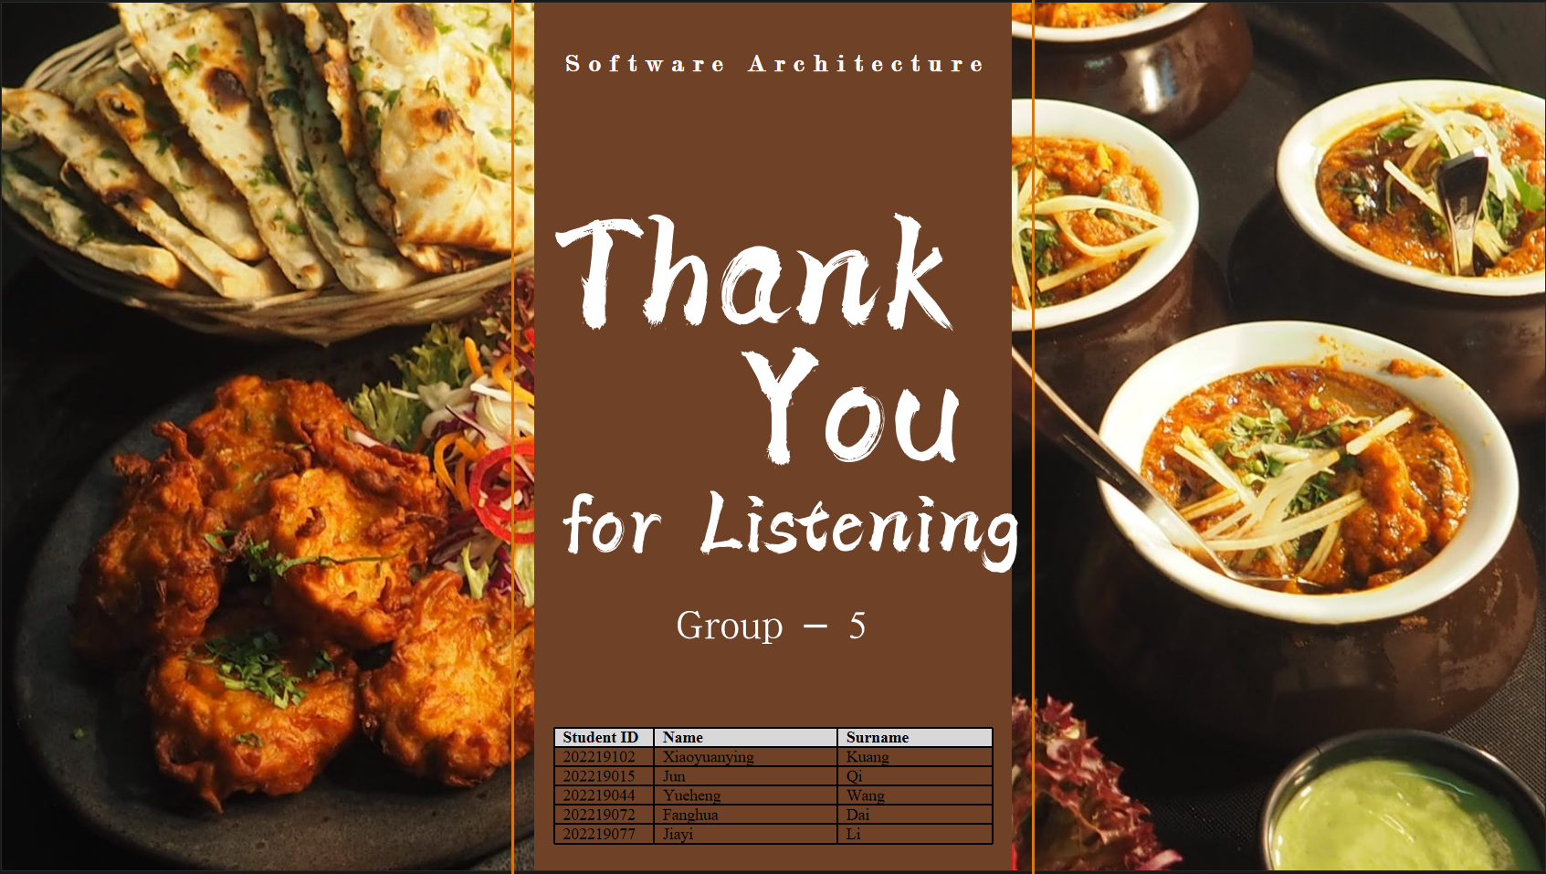
Software Architecture
Thank
You
for Listening
Group - 5
Student ID | Name | Surname
202219102 | Xiaoyuanying | Kuang
202219015 | Jun | Qi
202219044 | Yueheng | Wang
202219072 | Fanghua | Dai
202219077 | Jiayi | Li

